Slide 1



Presentation 2023
Discover The Mental Health Status Using Social Media Behavioral Patterns
24-25J-106

Slide 2

Content
01
Introduction
02
Functionalities
03
Our Team

Slide 3



INTRODUCTION
Topic: Discover The Mental Health Status Using Social Media Behavioral Patterns
Research group: Centre of Excellence for AI (CEAI)
Research area: Bio-Medical and Health Informatics (HI)
This research uses image processing and content analysis of social media behavior to assess mental health, aiming for early intervention and support by analyzing emotional responses, usage patterns, and demographics.

Slide 4


FUNCTIONALITIES
(Member Wise)

Slide 5
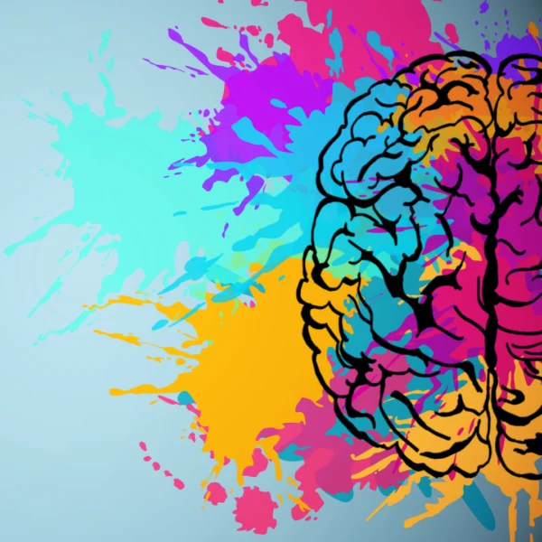


  Image Processing
  01
Facial Expression Analysis
Identify the short-term mental status

Slide 6
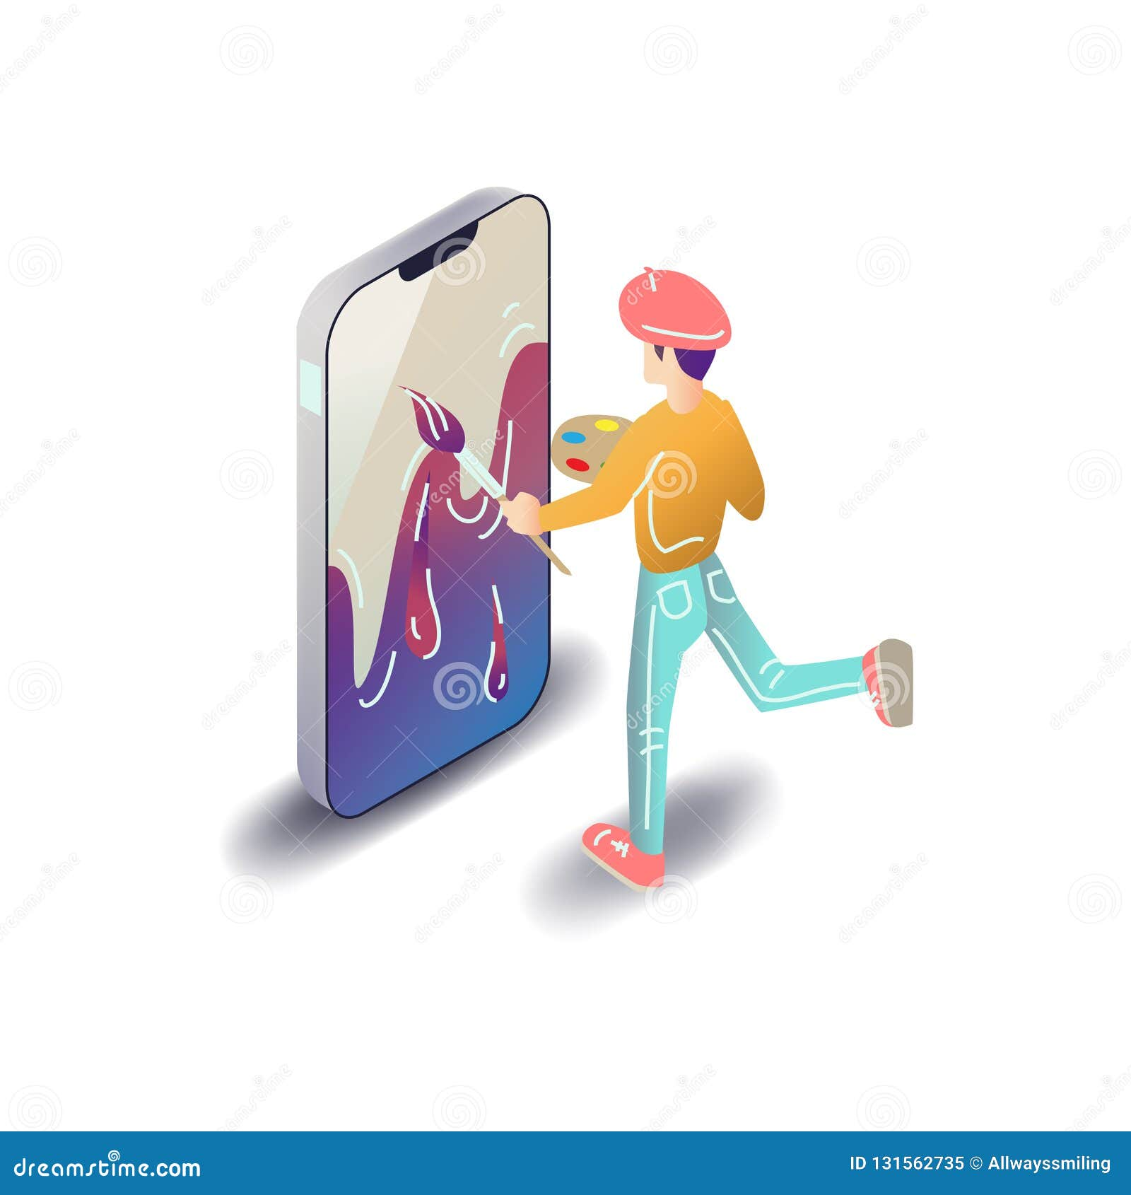



  Natural language processing
  02
  Image Processing
Identify the long-term mental status
  Content Analyzing

Slide 7



  Time & Location Tracking
  03
Track times and durations that user spends on the platform
  Time Durations

Slide 8






  Analyzing Data
  Develop a data model
  04
Analyze all databases and train a model
  Qualitative analysis
  Suggest solutions
  Quantitative analysis

Slide 9


Our Team
Student Name | IT Number | Functions
Amarasinghe R.A.D.T. | IT21292118 | Identify the short-term mental status
Ekanayaka E.M.C.S. | IT21371790 | Identify the long-term mental status
Nanayakkara A.A.R. | IT21700156 | Track times and durations that user spends on the platform
Senadheera W.D.N.D. | IT21220388 | Analyze all databases and train a model
Remy
Marsh

Slide 10

THANK YOU!

